Slide 1
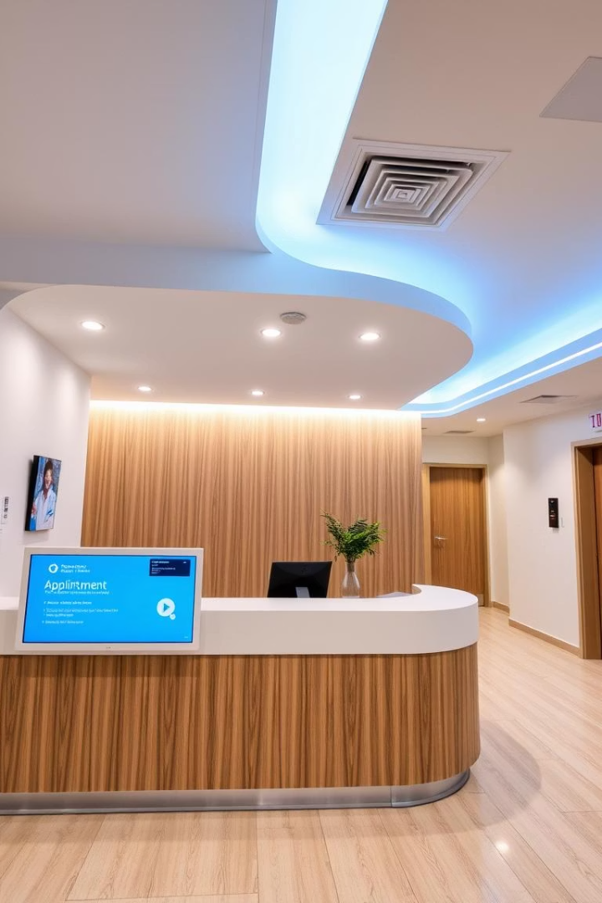
Hospital Appointment Management System
This web-based system, built with Python Flask, streamlines hospital appointments. It allows patients to book appointments and empowers administrators to manage bookings, doctors, and queries efficiently.
By,
Anvitha G Rao
52308042

Slide 2

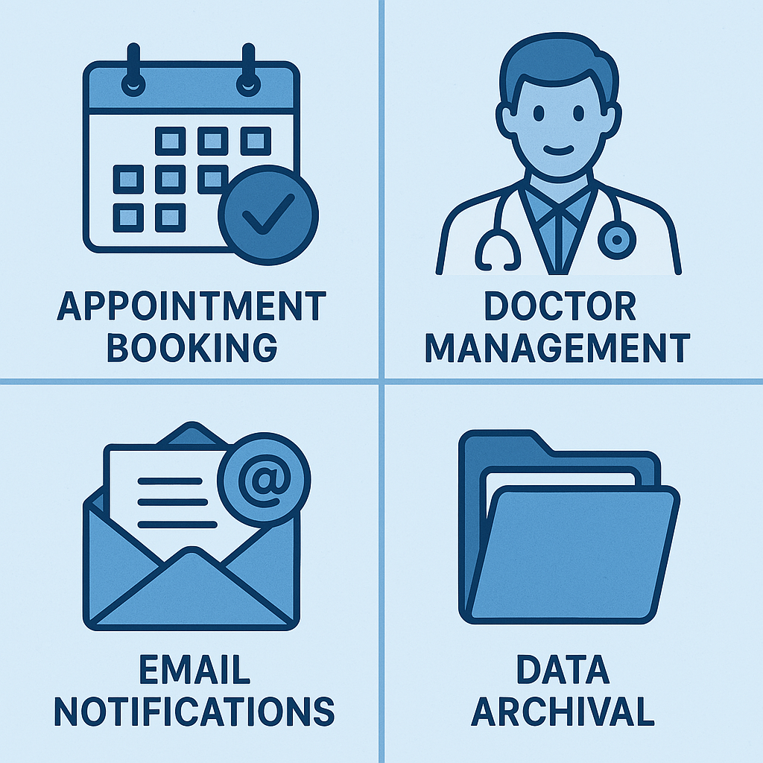



Core System Functionality
Appointment Booking
Patients can easily book appointments with doctors.
Email Notifications
Automated emails confirm appointments or waitlist status.
Doctor Management
Admins can add, toggle availability, and delete doctors.
Data Archival
Deleted appointments are moved to a history table.

Slide 3

Patient Module Features
Booking & Duplication
Patients book appointments. The system prevents duplicate bookings within 30 minutes.
Email Confirmation
Patients receive email confirmations with appointment details.
Conflict Resolution
If a slot is taken, the system assigns the next available time and sets a "waiting" status.

Slide 4





Input Validation & Security
Email Format
Phone Number
Date & Time
Validates email addresses (e.g., @gmail.com).
Checks for 10-digit phone numbers.
Restricts past dates/times. Booking is allowed 08:00-22:00.
Admin Security
Flask session-based authentication protects admin access.

Slide 5
Admin Module Capabilities
Dashboard View
Doctor Management
Admins see all confirmed and waiting appointments.
Add new doctors, toggle their availability, and delete records.
Appointment Management
Admin Management
Admins can view, delete, or bulk archive appointments.
Add or remove other administrators.

Slide 6

Database Structure
Appointment
Active appointments (id, name, email, doctor, time, status)
Doctor
Doctor details (id, name, specialization, is_active)
Admin
Admin login credentials (id, username, password)
AppointmentHistory
Archived appointments with deletion timestamp
ContactQuery
User messages from the contact form

Slide 7





Technology Stack
Backend
Python with Flask framework.
Frontend
HTML, CSS, and Jinja2 Templates.
Database
MySQL with SQLAlchemy ORM.
Notifications
Gmail SMTP for email alerts.

Slide 8
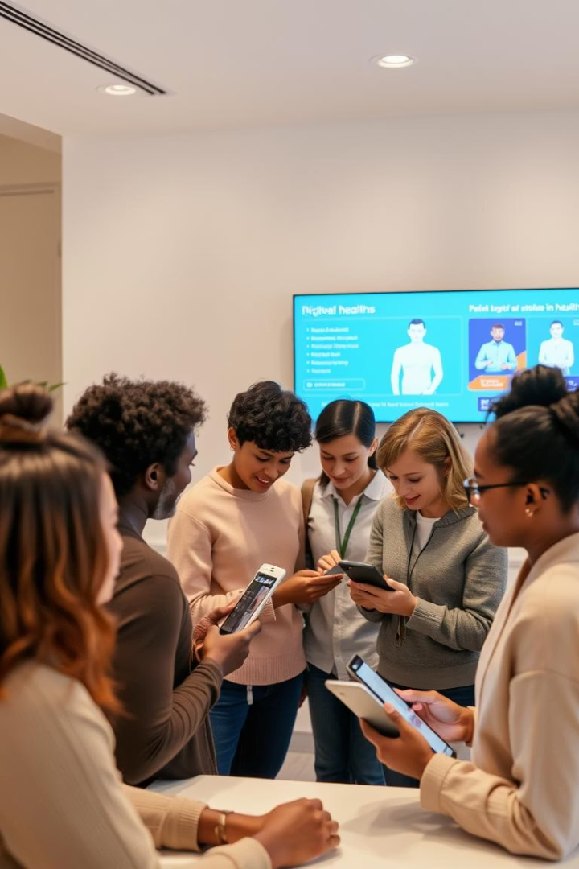
Key Use Cases
Hospitals/Clinics
Automate patient scheduling and manage doctors efficiently.
Patients
Self-service portal for instant appointment booking.
Support Teams
Collect and respond to patient queries via the contact form.

